Slide 1
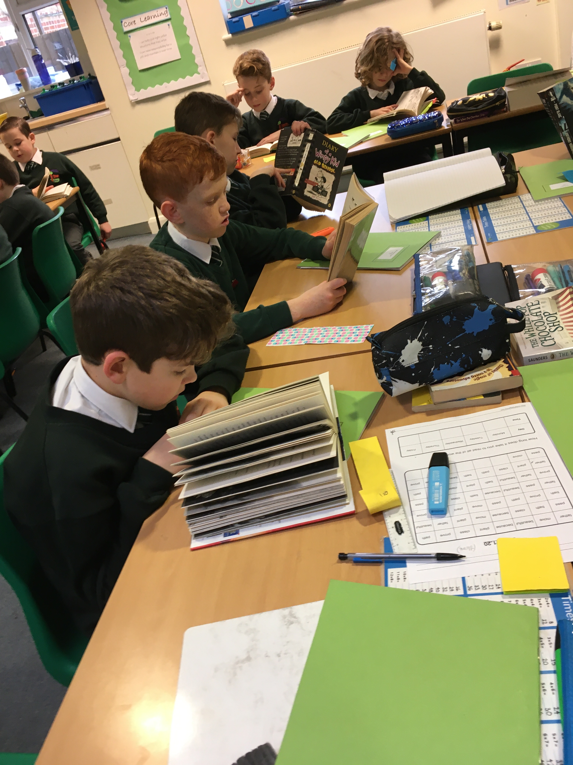
Reading Comprehension
Highwood Primary School

Slide 2
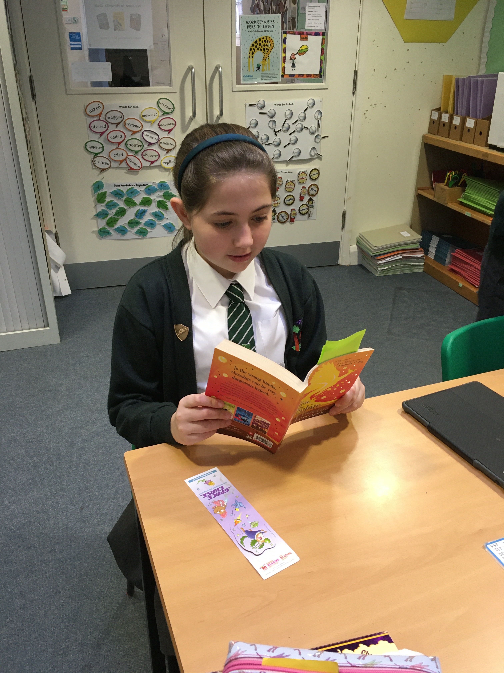
Reading Fluency
Reading fluency is very important
Should be confident in reading and decoding words
90-95%
Build up vocabulary

Slide 3
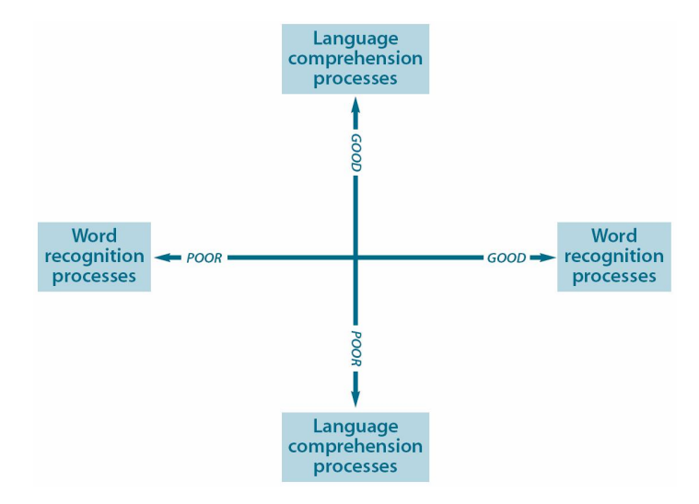
Reading Comprehension
Understanding What you read

Slide 4
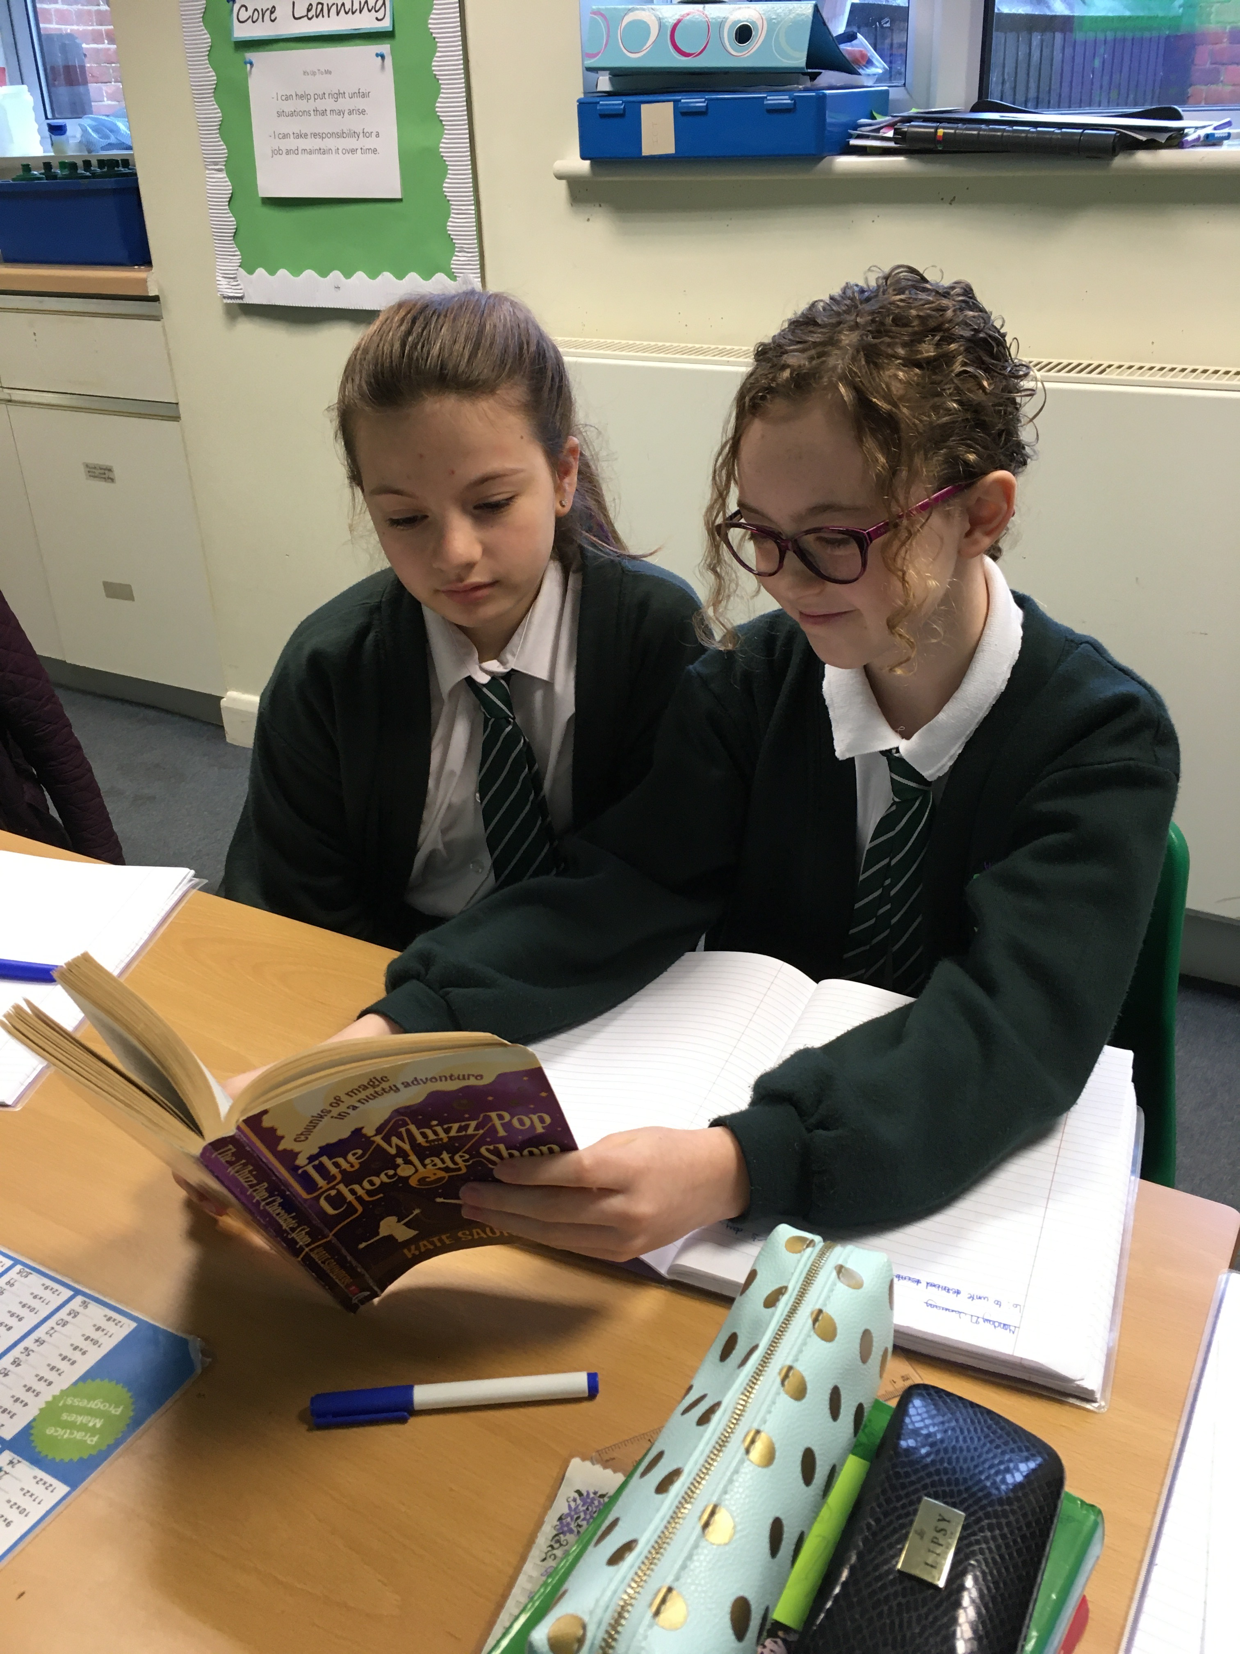
Literal/Retrieval questions
The looking and finding questions
Use memory and skim and scan

Slide 5
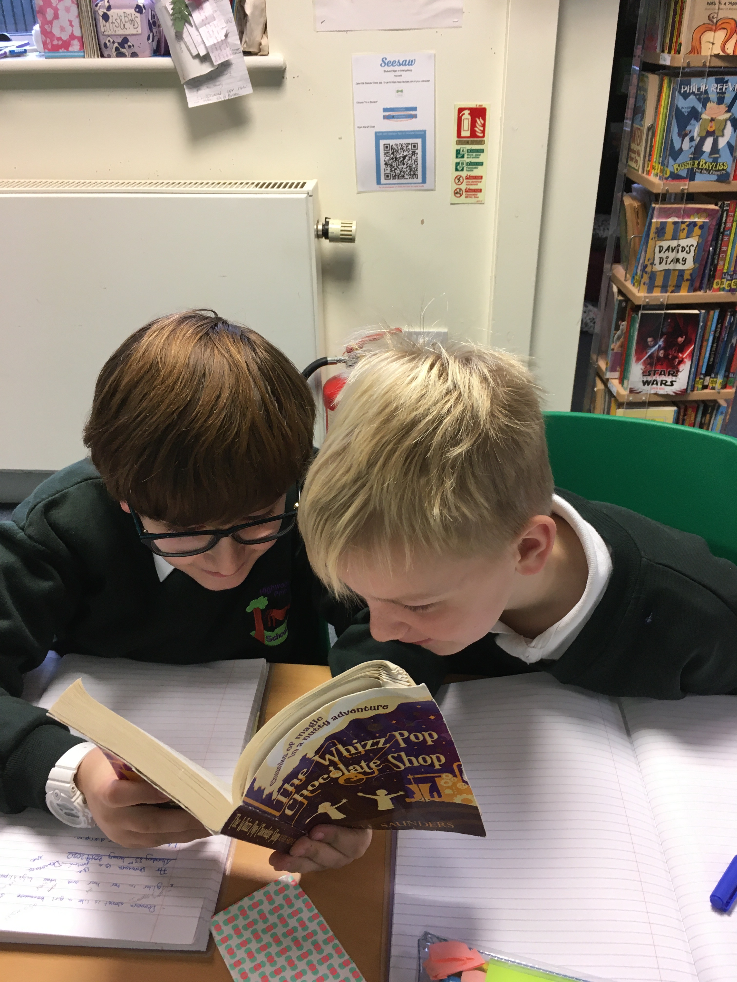
Inference Questions
The clue question
Children often find it hard to provide the evidence needed to support their point
What could that mean?

Slide 6
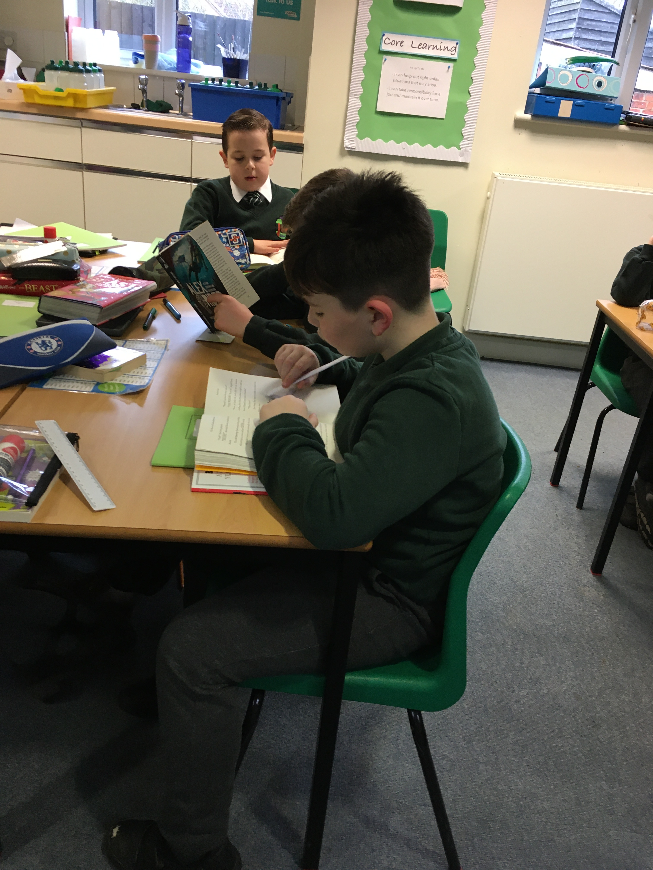
Deductive Questions
The thinking questions
Goes beyond the text

Slide 7
The Signposts

Slide 8
CONTRASTS & CONTRADICTIONS
This refers to when a character does something that contrasts with a reader’s expectations, or contradicts an earlier act or statement.
Students should think to themselves: Why is the character doing that? What does this help me infer about the character, plot or conflict?

Slide 9
WORDS OF THE WISER
This refers to when a character takes the main character aside and offers advice.
Students should think to themselves: What’s the life lesson and how might it affect the character? Often this lesson is the theme that the reader can take away from the story.

Slide 10
AHA! MOMENT
This refers to when a character realizes, understands or figures something out.
Students should think to themselves: How could this change things in the story for the character? What does this say about the conflict or the theme of the story?

Slide 11
AGAIN AND AGAIN
This refers to when the reader notices a word or phrase that the author may have mentioned over again.
Students should think to themselves: Why has the author done this? What does this tell me about the theme or conflict of the story? What message is the author trying to convey here?

Slide 12
MEMORY MOMENT
This refers to when the author shares a memory that the character has.
Students should think to themselves: Why is this memory important for the character?

Slide 13
TOUGH QUESTIONS
This refers to when the character asks himself or herself a difficult question.
Students should think to themselves: What does this question make him wonder about? How does the character deal with this question?

Slide 14
Read, read, read
Keep reading with your children, regardless of their age.
Take turns and discuss the characters, plot points and interesting events.
Make connections to their life and things they have done.

