Slide 1



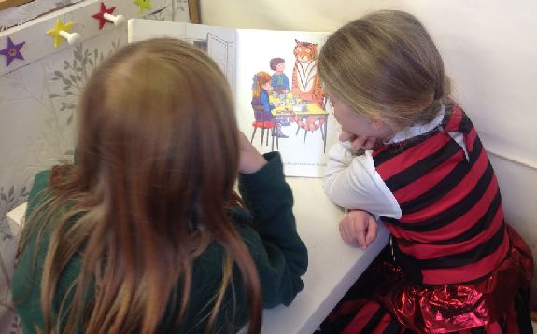

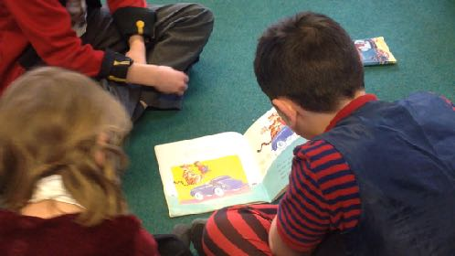
Reading Workshop
28th January 2020

Slide 2
Key Questions???
How can we help our children become more fluent readers?
How can we improve our child’s understanding of the text?

Slide 3
The ability to read is vital
It paves the way for success in school and later life.
Research shows that it's the single most important thing you can do to help your child's education.
There are many reasons why we read and therefore why children will read:
for pleasure and interest
for work
to learn about the world e.g. in papers
to obtain information e.g. recipes and signs

Slide 4

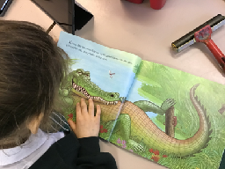
Fluency: What is it?
Why is it important?
Reading fluency is a child's ability to read a book or other text correctly, quickly, and with expression.
A fluent reader doesn't have to stop and "decode" each word. Rather, most of the words can be read automatically. This means the reader can focus his attention on what the story or text means.
For that reason, fluency is critically important — it is the bridge between decoding words and understanding what has been read.

Slide 5
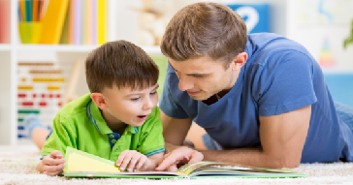
How can we foster reading fluency?
Parents can help their child develop
reading fluency through a few simple
and fun activities
Paired or "Buddy" Reading
The easiest and best way to help your child develop fluency is to sit with your child and read! Read together every day, which is often called paired or buddy reading. To use paired reading, simply take turns reading aloud. You go first, as your reading provides a model of what good fluent reading sounds like. Then, ask your child to re-read the same page you just read. You'll notice that your child's reading will start to sound more and more like yours. Do this for several pages. Once your child is comfortable enough, and familiar enough with the book, take turns reading page for page.

Slide 6

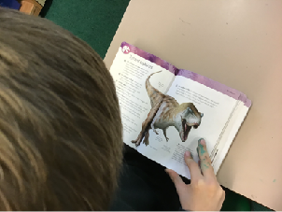
Re-read Favourite Books
One way parents can help develop fluency is to build a tall stack of books that your child can read quickly and easily. Encourage your child to re-read favourite books over and over again. With each reading, you may notice your child reading a bit easier, a bit faster, and with a bit more confidence and expression.
Sing Along!
A great way to work on fluency is using song words.
Letting children sing karaoke or listen to songs using a
Music app allows the children a chance to read words
they know at speed. You just might need some earphones!
Record It
Another fun way to practice reading and build fluency is to have your child create their own audio books. This can be done simply with an ipad or mobile device or on an audio app (like Book creator). Regardless of the method you choose, your child will be practicing what they want to record and that reading practice is critical. Sharing your audio recordings with family and friends is a great motivator too!
These activities are easy and require very few materials. Doing these activities with your child will help build fluency — a skill that will last a lifetime!

Slide 7

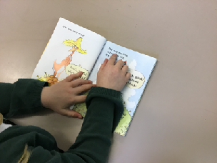
Word Recognition
The ability to recognise words presented in and out of context.
The ability to apply phonic rules - blending phonemes to decode.
Comprehension
The process by which word information, sentences and text are interpreted.
The same processes underlie comprehension of both oral and written language.
Continues to develop throughout life!

Slide 8
What are the barriers to your child’s comprehension?
Understanding of language/vocabulary
Exposure to good quality texts
Lack of real life experience/ Knowledge of the world
Fluency and expression when reading

Slide 9
Understanding Vocabulary
Pupils who do not know at least 90-95% of the words in a text will not comprehend it.

Slide 10
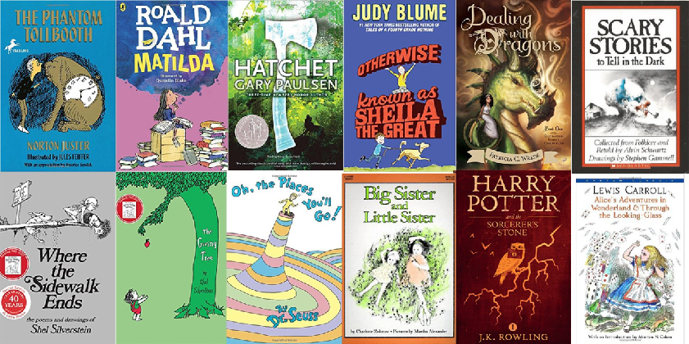
Read a good quality text
It is great for children to re-read their favourite books as it’s most important that they love to read!
However, once your child is becoming more fluent it is key that they read a variety of texts, both fiction and non-fiction.
There are many excellent authors but some children’s books don’t do enough to stretch your child’s vocabulary and to get them thinking at a higher level.
Are there words in the books that make them think?
https://schoolreadinglist.co.uk/category/reading-lists-for-ks2-school-pupils/

Slide 11



How can I improve my child’s
knowledge of the world?
To be able to understand texts children need to make connections to real life or to other things they have read or seen.
As your child experiences new things their knowledge of the world grows. It is important to talk to them about the things around them and to relate their experiences to others. Try to encourage your child to read non-fiction texts too. The ‘First News’ and ‘The Week’ is a great resource and fun to read! Also watching ‘Newsround’ can help with their general knowledge.
The more we get children to read or experience, the better their understanding will be.
Ask questions, encourage them to ask you!

